Slide 1
About Me
Ritesh Singh
Sun Certified java Professional
Oracle Certified Database Administrator
Certified Ethical Hacker
Certified EC-Council Instructor (CEI)

Slide 2
Course Overview
MySQL ORDER BY

Slide 3
Introduction to MySQL SELECT statement
Introduction to MySQL ORDER BY clause
When you use the SELECT statement to query data from a table, the result set is not sorted. It means that the rows in the result set can be in any order.
To sort the result set, you add the ORDER BY clause to the SELECT statement. The following illustrates the syntax of the ORDER BY clause:

Slide 4
SELECT
select_list
FROM
table_name
ORDER BY
column1 [ASC|DESC],
column2 [ASC|DESC],
...;
In this syntax, you specify the one or more columns which you want to sort after the ORDER BY clause.

Slide 5
The ASC stands for ascending and the DESC stands for descending. You use ASC to sort the result set in ascending order and DESC to sort the result set in descending order.
This ORDER BY clause sorts the result set in ascending order:
ORDER BY column1 ASC;
And this ORDER BY clause sorts the result set in descending order:
ORDER BY column1 DESC;
By default, the ORDER BY clause uses ASC if you don’t explicitly specify any option.

Slide 6
Therefore, the following clauses are equivalent:
ORDER BY column1 ASC;
and
ORDER BY column1;
If you want to sort the result set by multiple columns, you specify a comma-separated list of columns in the ORDER BY clause:
ORDER BY
column1,
column2;

Slide 7
It is possible to sort the result by a column in ascending order, and then by another column in descending order:
ORDER BY
column1 ASC,
column2 DESC;

Slide 8

In this case, the ORDER BY clause:
First, sort the result set by the values in the column1 in ascending order.
Then, sort the sorted result set by the values in the column2 in descending order. Note that the order of values in the column1 will not change in this step, only the order of values in the column2 changes.
Note that the ORDER BY clause is always evaluated after the FROM and SELECT clause.

Slide 9
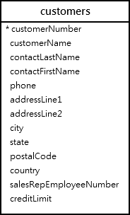
MySQL ORDER BY examples
We’ll use the customers table from the sample database for the demonstration.

Slide 10
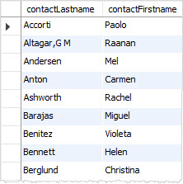
A) Using MySQL ORDER BY clause to sort values in one column example
The following query uses the ORDER BY clause to sort the customers by the values in the contactLastName column in ascending order.
SELECT
contactLastname,
contactFirstname
FROM
customers
ORDER BY
contactLastname;

Slide 11
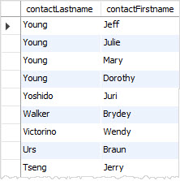
If you want to sort customers by the last name in the descending order, you use the DESC after the contactLastname column in the ORDER BY clause as shown in the following query:
SELECT
contactLastname,
contactFirstname
FROM
customers
ORDER BY
contactLastname DESC;

Slide 12
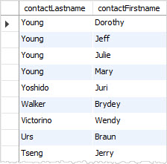
B) Using MySQL ORDER BY clause to sort values in multiple columns example
If you want to sort the customers by the last name in descending order and then by the first name in ascending order, you specify both DESC and ASC in the corresponding column as follows:
SELECT
contactLastname,
contactFirstname
FROM
customers
ORDER BY
contactLastname DESC,
contactFirstname ASC;

Slide 13
In this example, the ORDER BY clause sorts the result set by the last name in descending order first and then sorts the sorted result set by the first name in ascending order to produce the final result set.

Slide 14
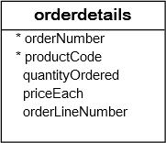
C) Using MySQL ORDER BY to sort a result set by an expression example
See the following orderdetails table from the sample database.

Slide 15
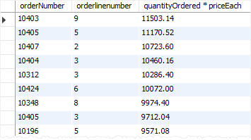
The following query selects the order line items from the orderdetails table. It calculates the subtotal for each line item and sorts the result set based on the subtotal.
SELECT
orderNumber,
orderlinenumber,
quantityOrdered * priceEach
FROM
orderdetails
ORDER BY
quantityOrdered * priceEach DESC;

Slide 16
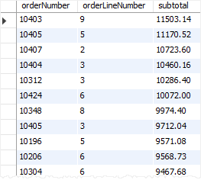
To make the query more readable, you can assign the expression in the SELECT clause a column alias and use that column alias in the ORDER BY clause as shown in the following query:
SELECT
orderNumber,
orderLineNumber,
quantityOrdered * priceEach AS subtotal
FROM
orderdetails
ORDER BY subtotal DESC;

Slide 17
In this example, we used subtotal as the column alias for the expression quantityOrdered * priceEach and sorted the result set by the subtotal alias.
The column alias can be used in the ORDER BY clause because the SELECT clause is evaluated before the ORDER BY clause. By the time the ORDER BY clause is evaluated, the column alias is accessible.

Slide 18
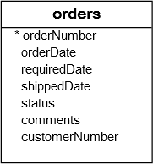
Using MySQL ORDER BY to sort data using a custom list
The ORDER BY clause allows you to sort data using a custom list by using the FIELD() function.
See the following orders table from the sample database.

Slide 19
Suppose that you want to sort the sales orders based on their statuses in the following order:
In Process
On Hold
Canceled
Resolved
Disputed
Shipped
To do this, you can use the FIELD() function to map each order status to a number and sort the result by the result of the FIELD() function:

Slide 20
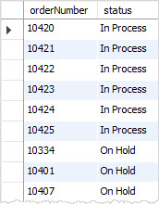
SELECT
orderNumber,
status
FROM
orders
ORDER BY
FIELD(status,
'In Process',
'On Hold',
'Cancelled',
'Resolved',
'Disputed',
'Shipped');

Slide 21
The following expression:
FIELD(status, 'In Process', 'On Hold', 'Cancelled', 'Resolved', 'Disputed', 'Shipped');
returns the index of the status in the list 'In Process', 'On Hold', 'Cancelled', 'Resolved', 'Disputed', 'Shipped'.
For example, if the status is In Process, the function will return 1. If the status is On Hold, the function will return 2, and so on.

Slide 22
Thank You
Please Subscribe My Channel
https://www.youtube.com/channel/UCYW3PWPOPn3qgxxjhUbXXXg?view_as=subscriber

